Slide 1
Cooking with AWS and Splunk
Module 3 : Setting up Splunk Infrastructure
Kam Amir | Splunk Cloud Architect

Slide 2
Deployment Options
Splunk Cloud Sales Trial
Fast Free Deployment
AWS Marketplace AMI
Deploy Splunk in customer VPC
"Quick Start" Cloud Formation Template
15 Day Trial
Extended Deployment
Build out full Splunk Enterprise Stack
Scale out for large data ingest
Notes:
There are three quick ways to start using Splunk in AWS. First, you can deploy a free Splunk Cloud sales trial. This free trial allows you to quickly start using Splunk and have an instance to collect your AWS data. The AWS Marketplace AMI gives you more control over the Splunk instance. If you are unable to use a sales trial, or want it longer than 15 days this would be the recommended approach. Finally, if you need an enterprise ready deployment of Splunk, then it would be recommended that you use the CloudFormation templates to setup the three tiered Splunk enviornment.

Slide 3
Setup Splunk Enterprise on AWS
Splunk Cloud Sales Trial vs. AMI (Amazon Machine Image)
Log into http://www.splunk.com Select Free Splunk
Create Splunk Cloud Sales Trial (15 days)
Install AWS App and dependencies Setup AWS Account / Inputs
Setup HTTP Event Collector (HEC)
Overview for AMI deployment
Go to https://aws.amazon.com/marketplace search for “splunk”
Deploy Splunk Enterprise AMI in your AWS environment
Setup Splunk App for AWS
Install Dependencies for AWS App
Setup HTTP Event Collector (HEC)
Notes:
For a Splunk Cloud sales trial, log into Splunk and click on Free Splunk. Now select Cloud trial and click OK. Your sales trial will spin up in a few minutes and you should be able to start using it soon thereafter. For the Marketplace AMI, go to https://aws.amazon.com/marketplace and search for Splunk. Select the Splunk Enterprise item and launch it manually. Make sure to add additional storage so that you do not run into any space constraint issues with your AWS instance. I would recommend attaching a 100GB GP2 EBS volume. Once your instance is up, then log into your deployment and install the Splunk App for AWS, the Add-on for AWS and the other dependencies listed in the next slide.

Slide 4
Setup AMI from AWS Marketplace

Slide 5
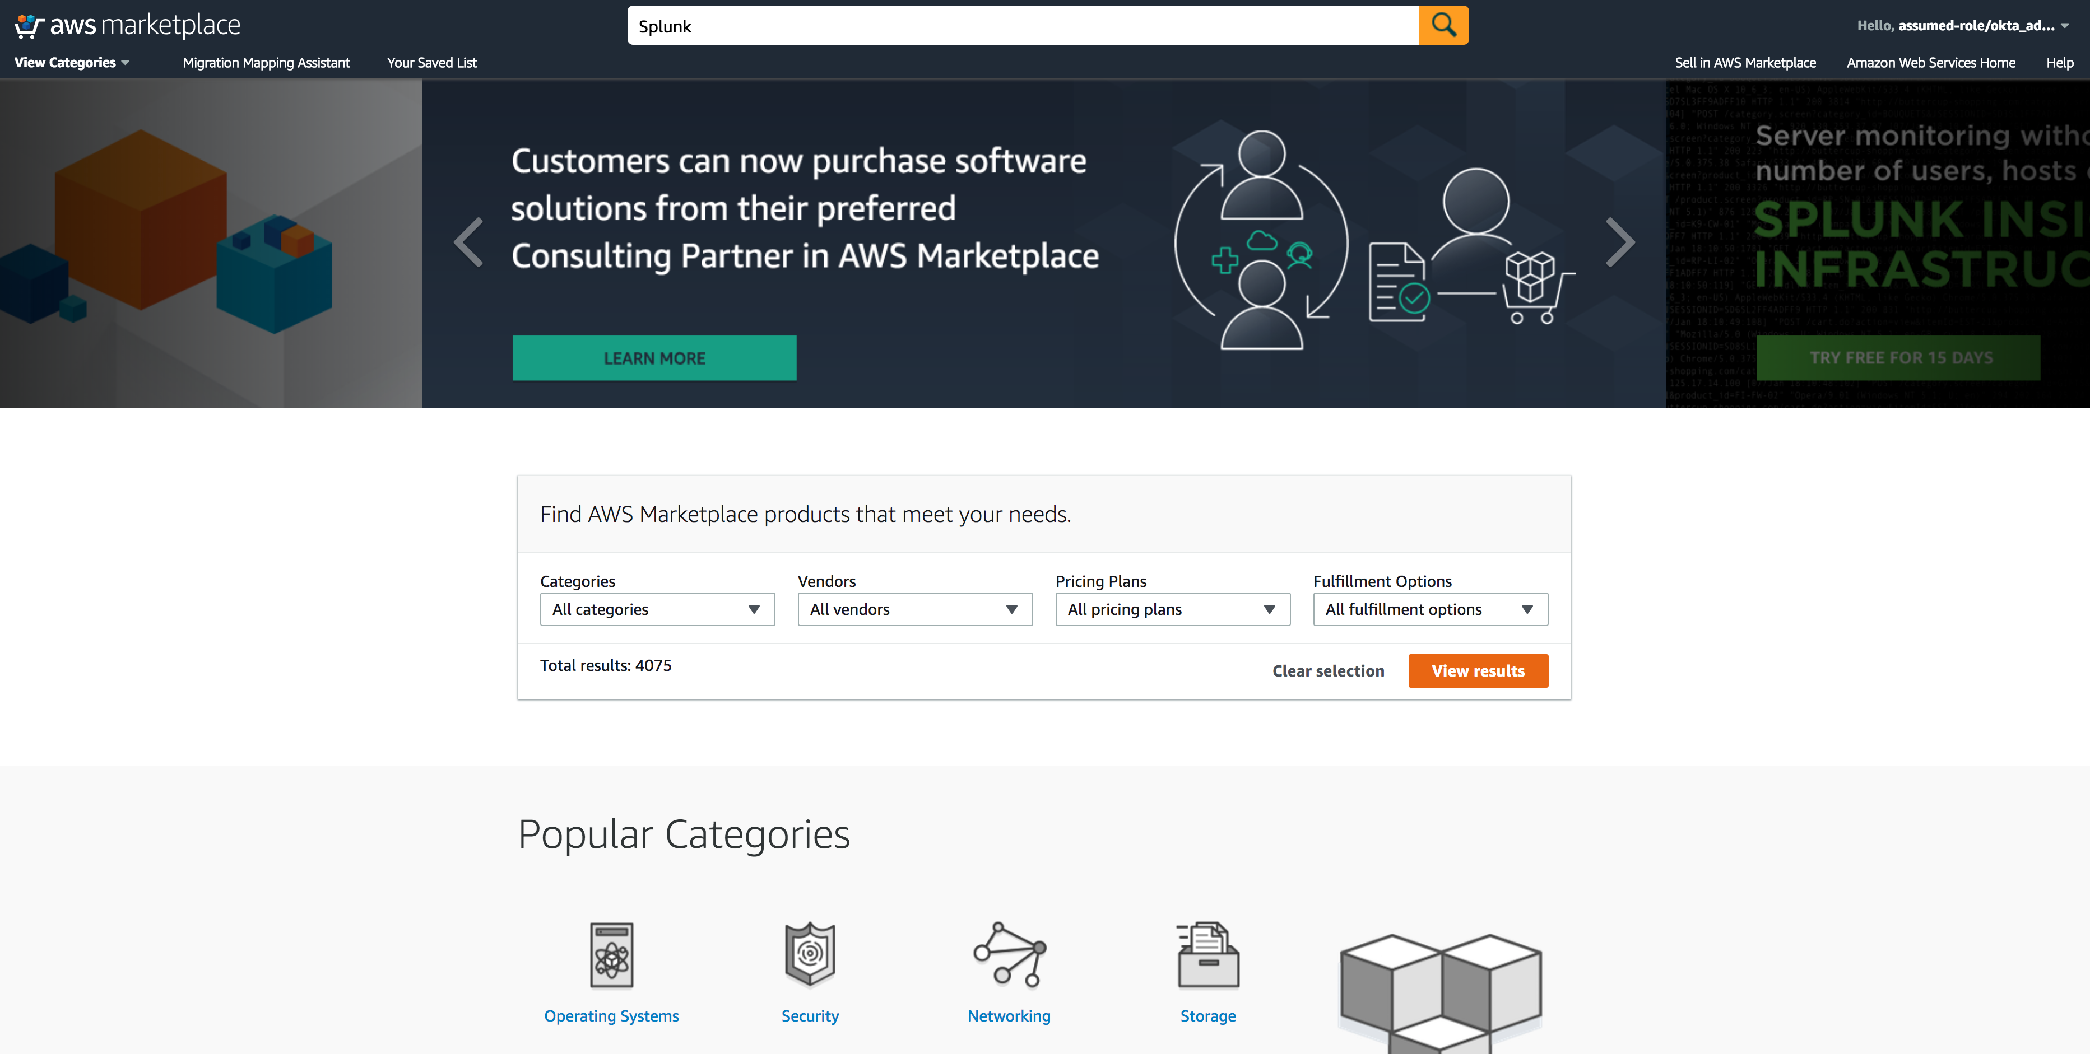
Go to AWS Market Place
Go to https://aws.amazon.com/marketplace, search for Splunk

Slide 6
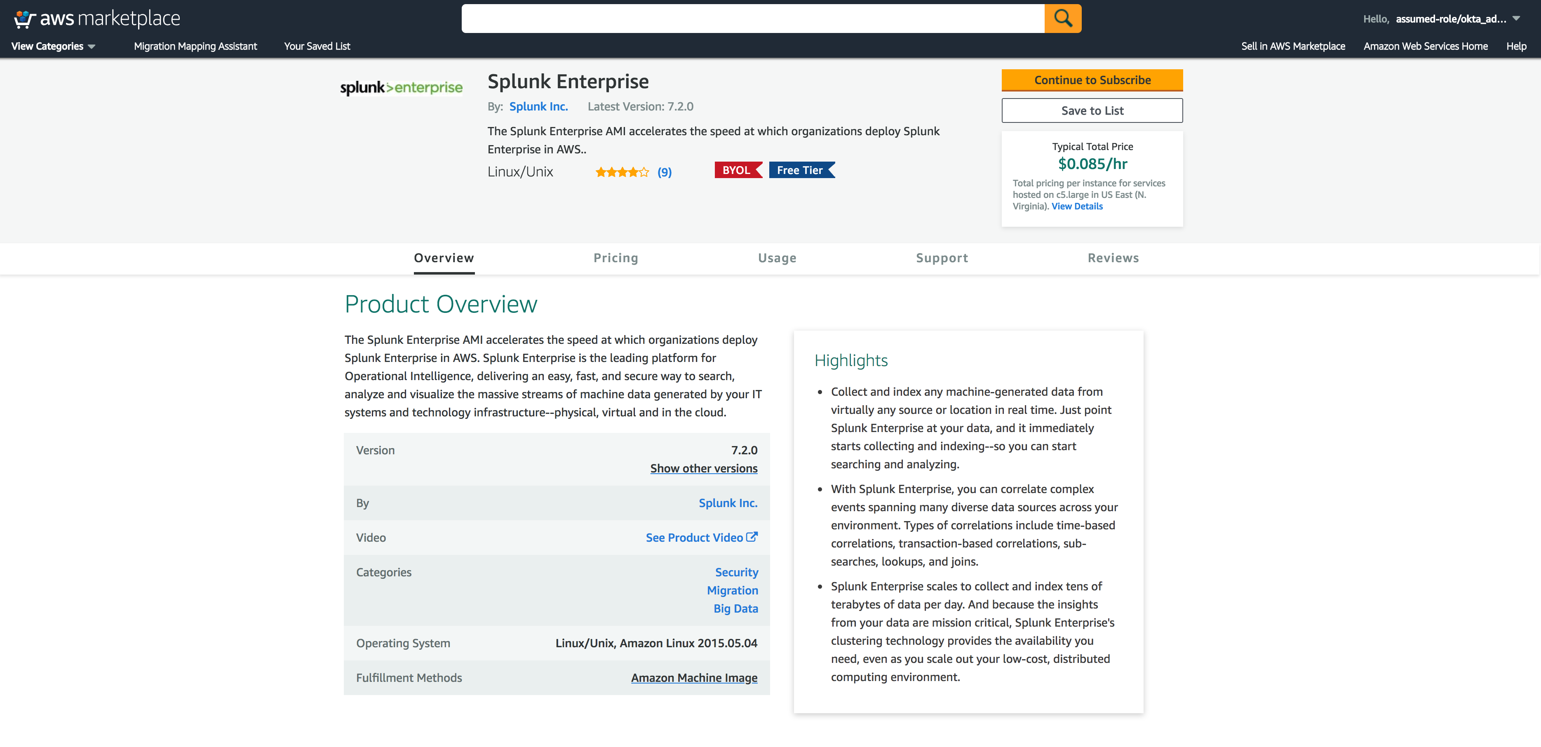
Find Splunk Enterprise
Click Continue (Sign Into AWS)
Click Here

Slide 7
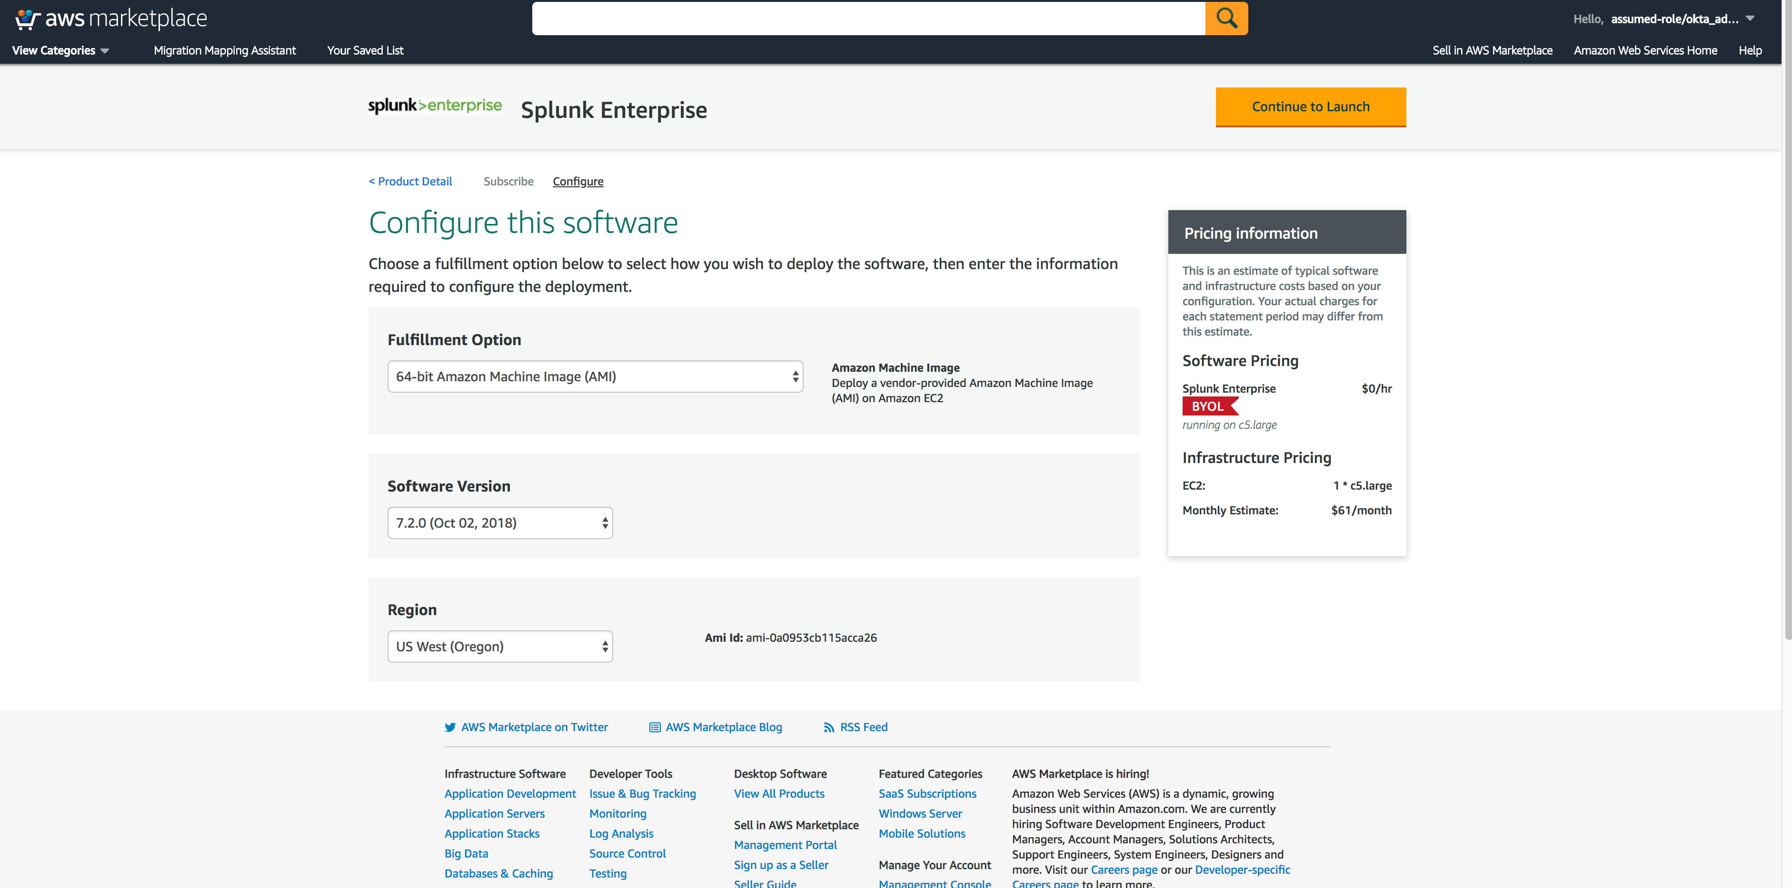
Find Splunk Enterprise
Click Continue (Sign Into AWS)
Click Here

Slide 8
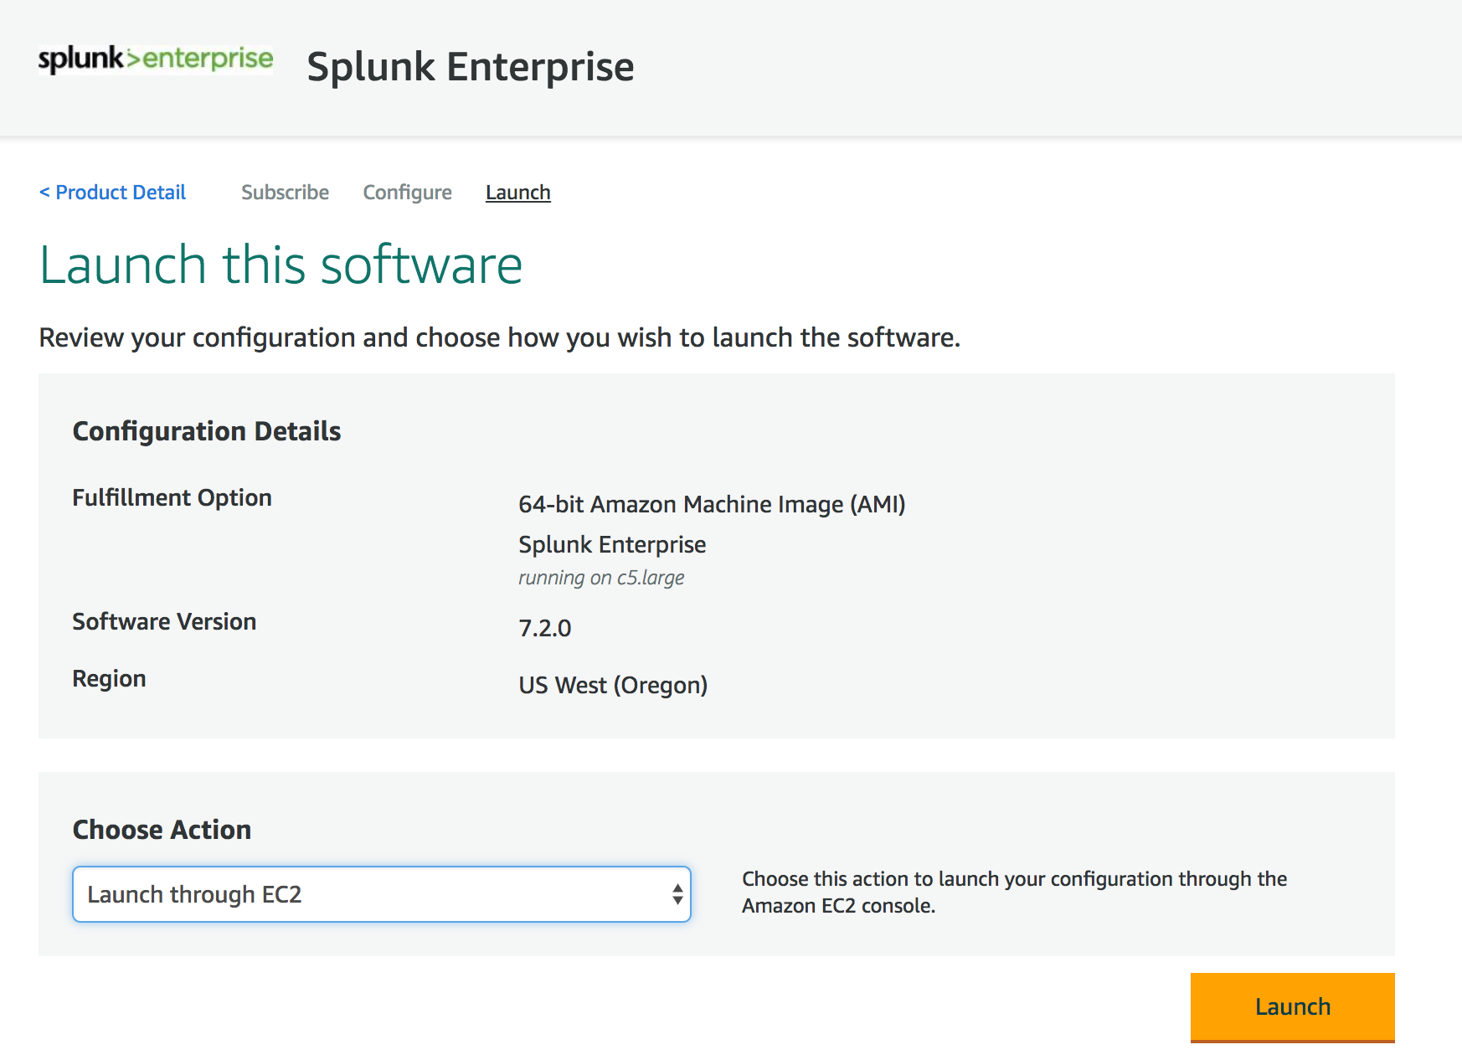
Launch Splunk Enterprise
Choose:
Launch through EC2
Click Here

Slide 9
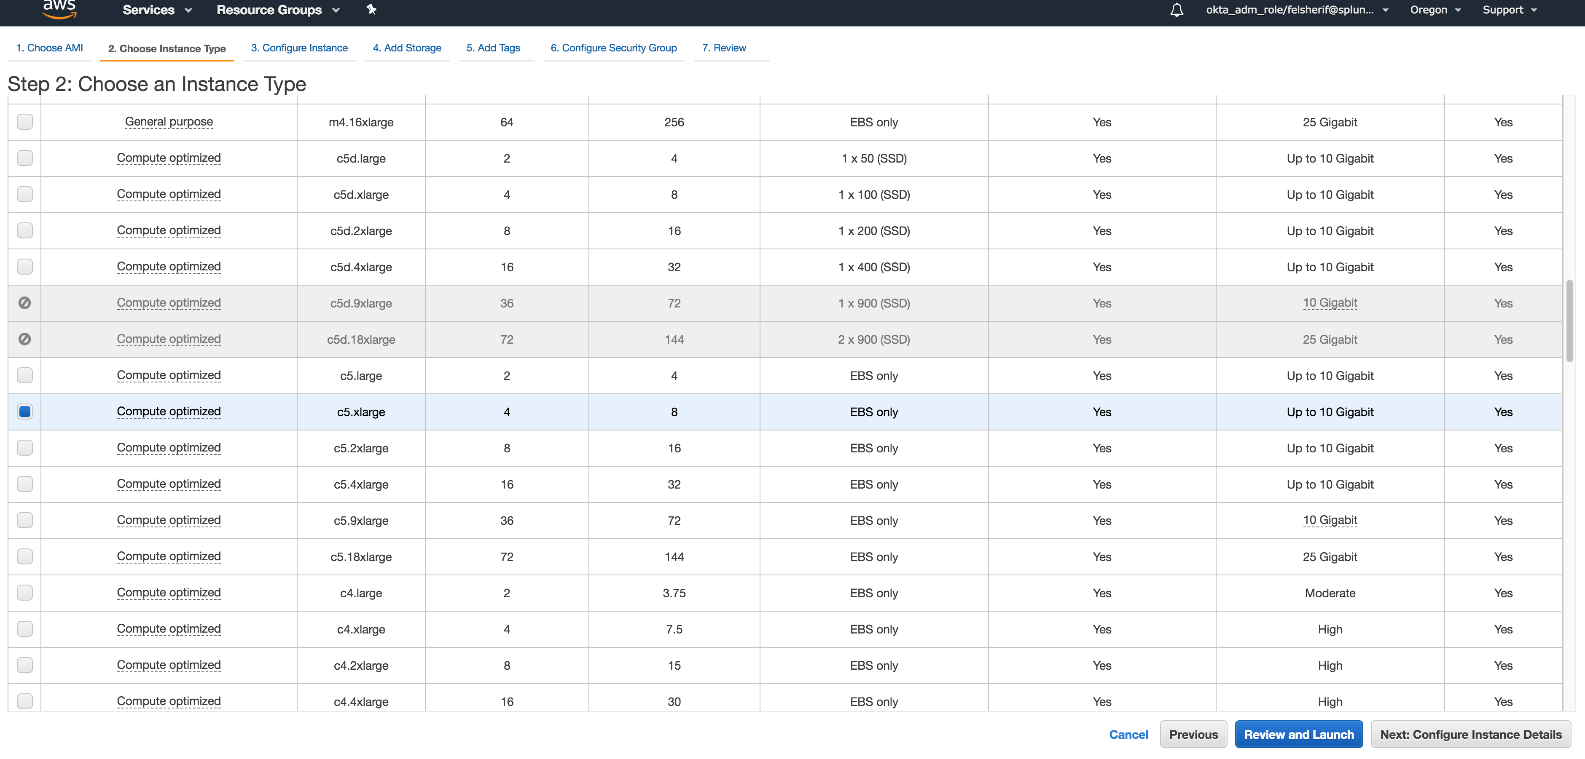
Choose type (c5.xlarge)
Click Here

Slide 10
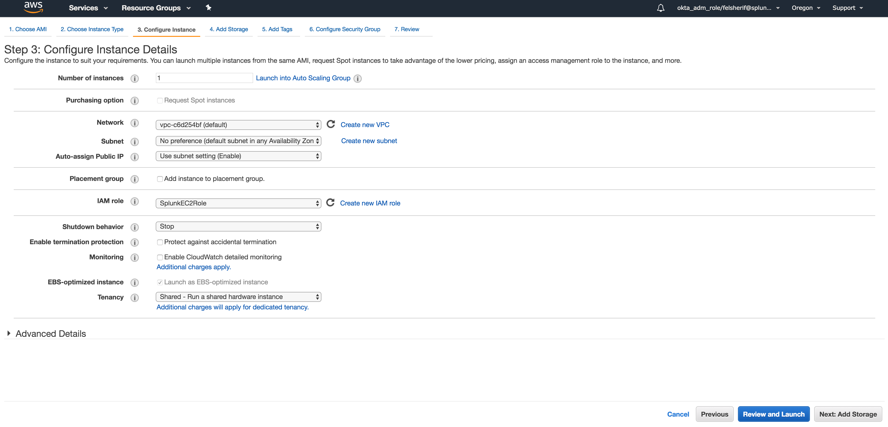
Configure instance
Choose:
SplunkEC2Role
Click Here

Slide 11
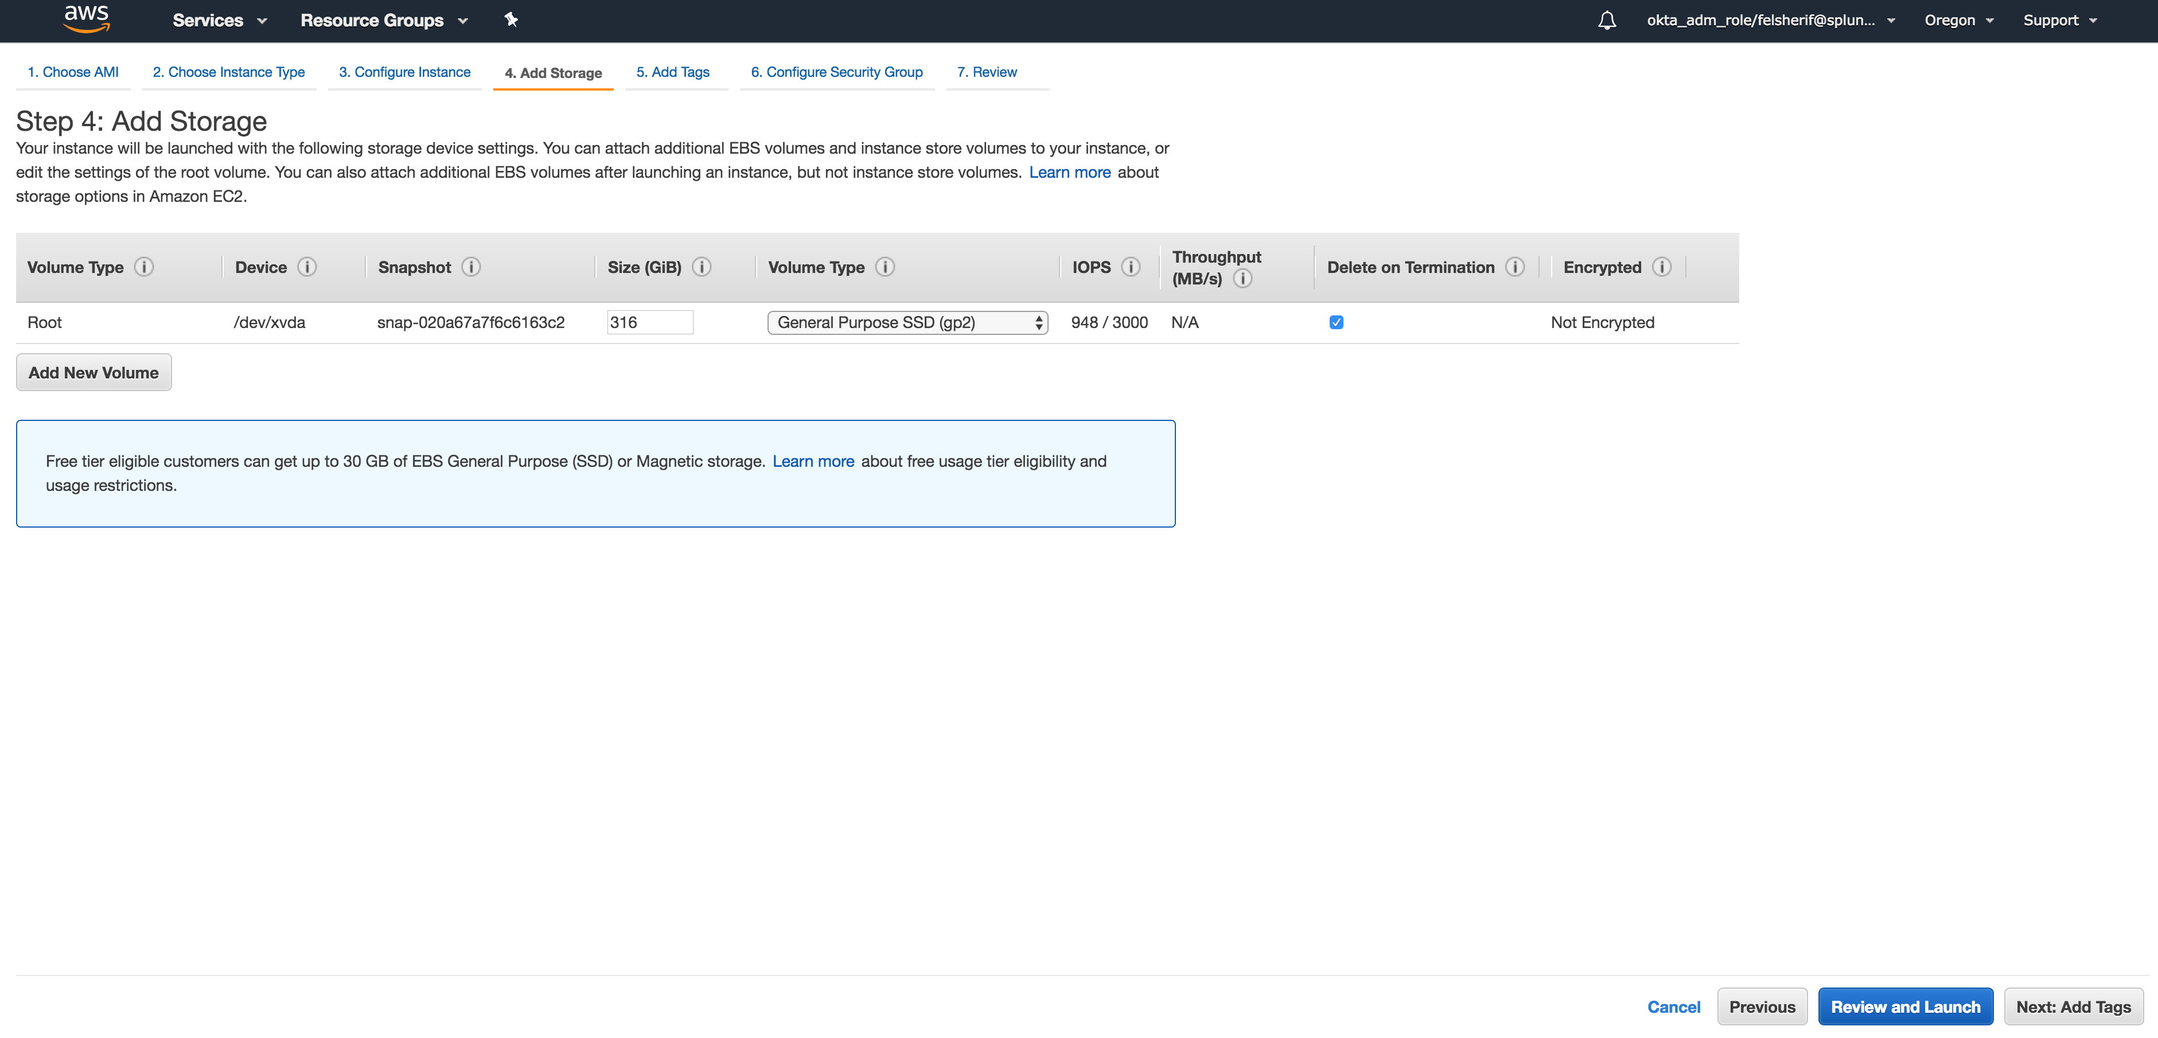
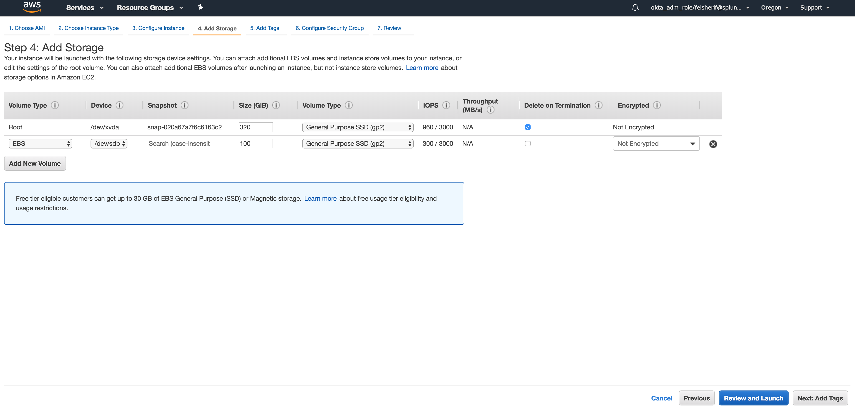
Add Storage
Add New Volume
Attach a 100GB GP2 EBS volume
Click Here

Slide 12
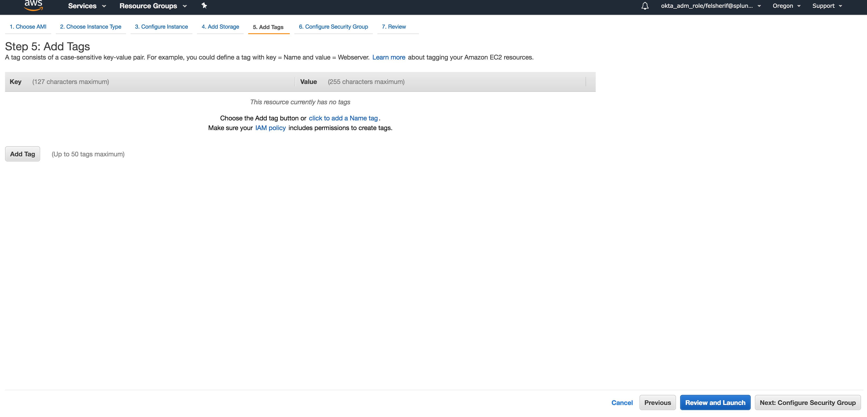
Tags (skip)
Click Here

Slide 13
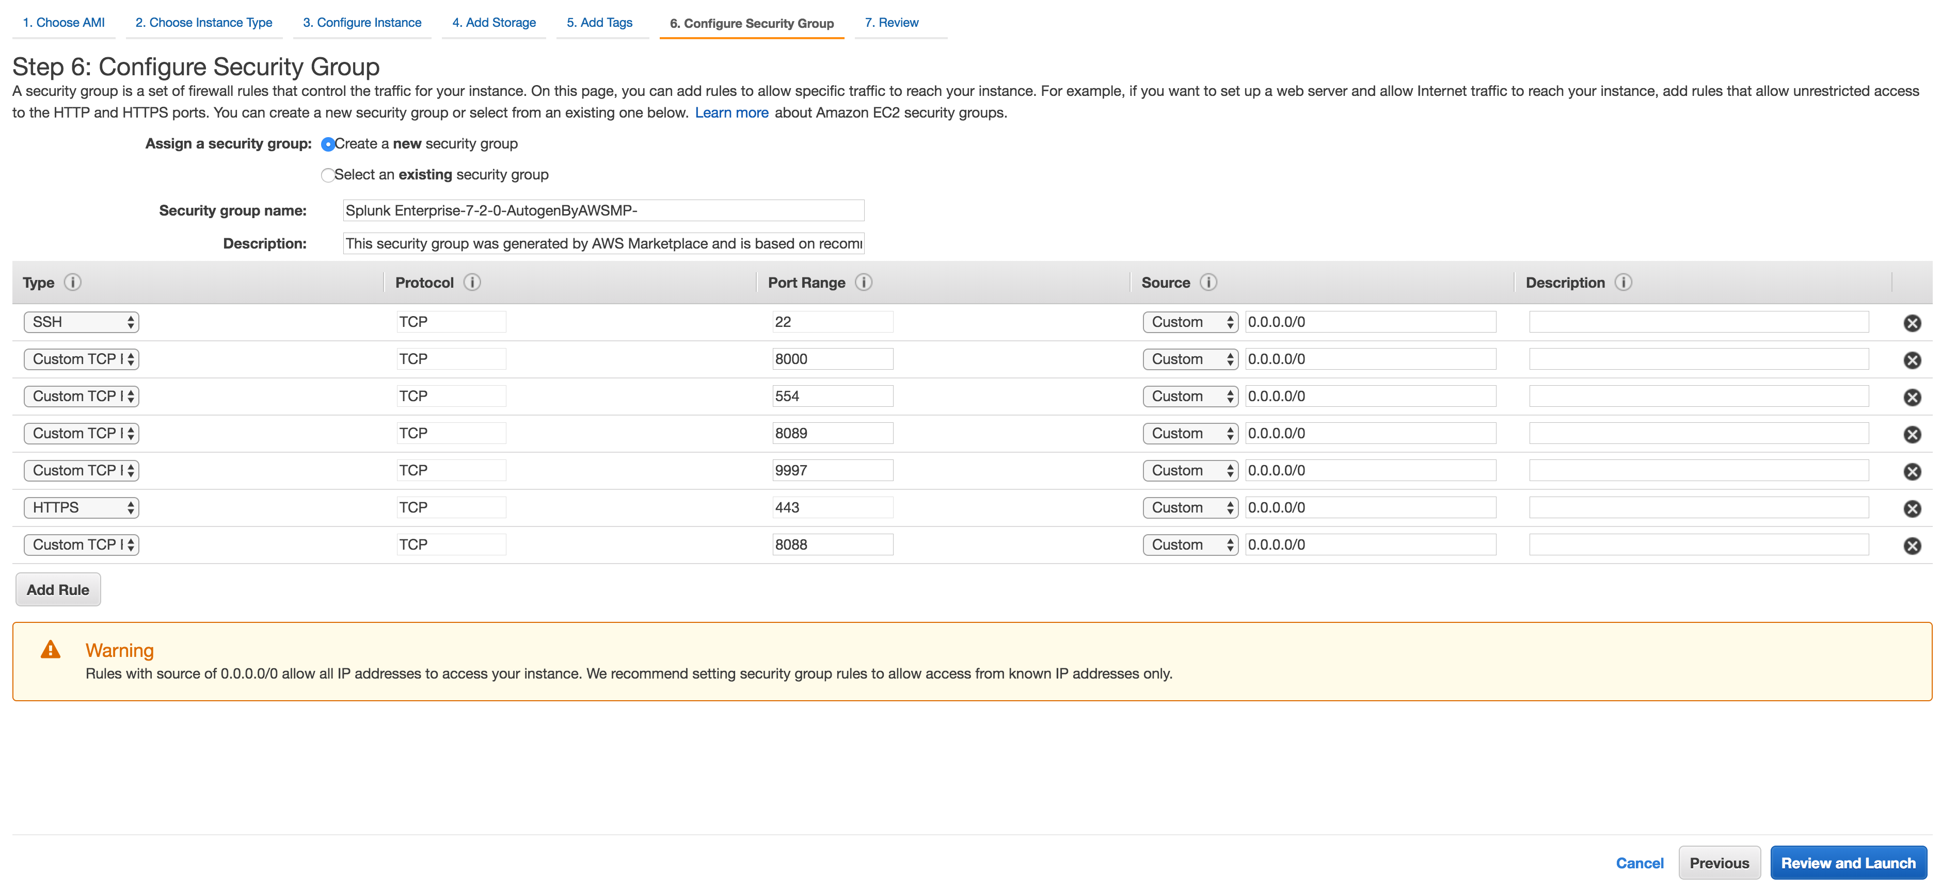
Configure Security Group
Add Port 8088 (TCP)
Click Here

Slide 14
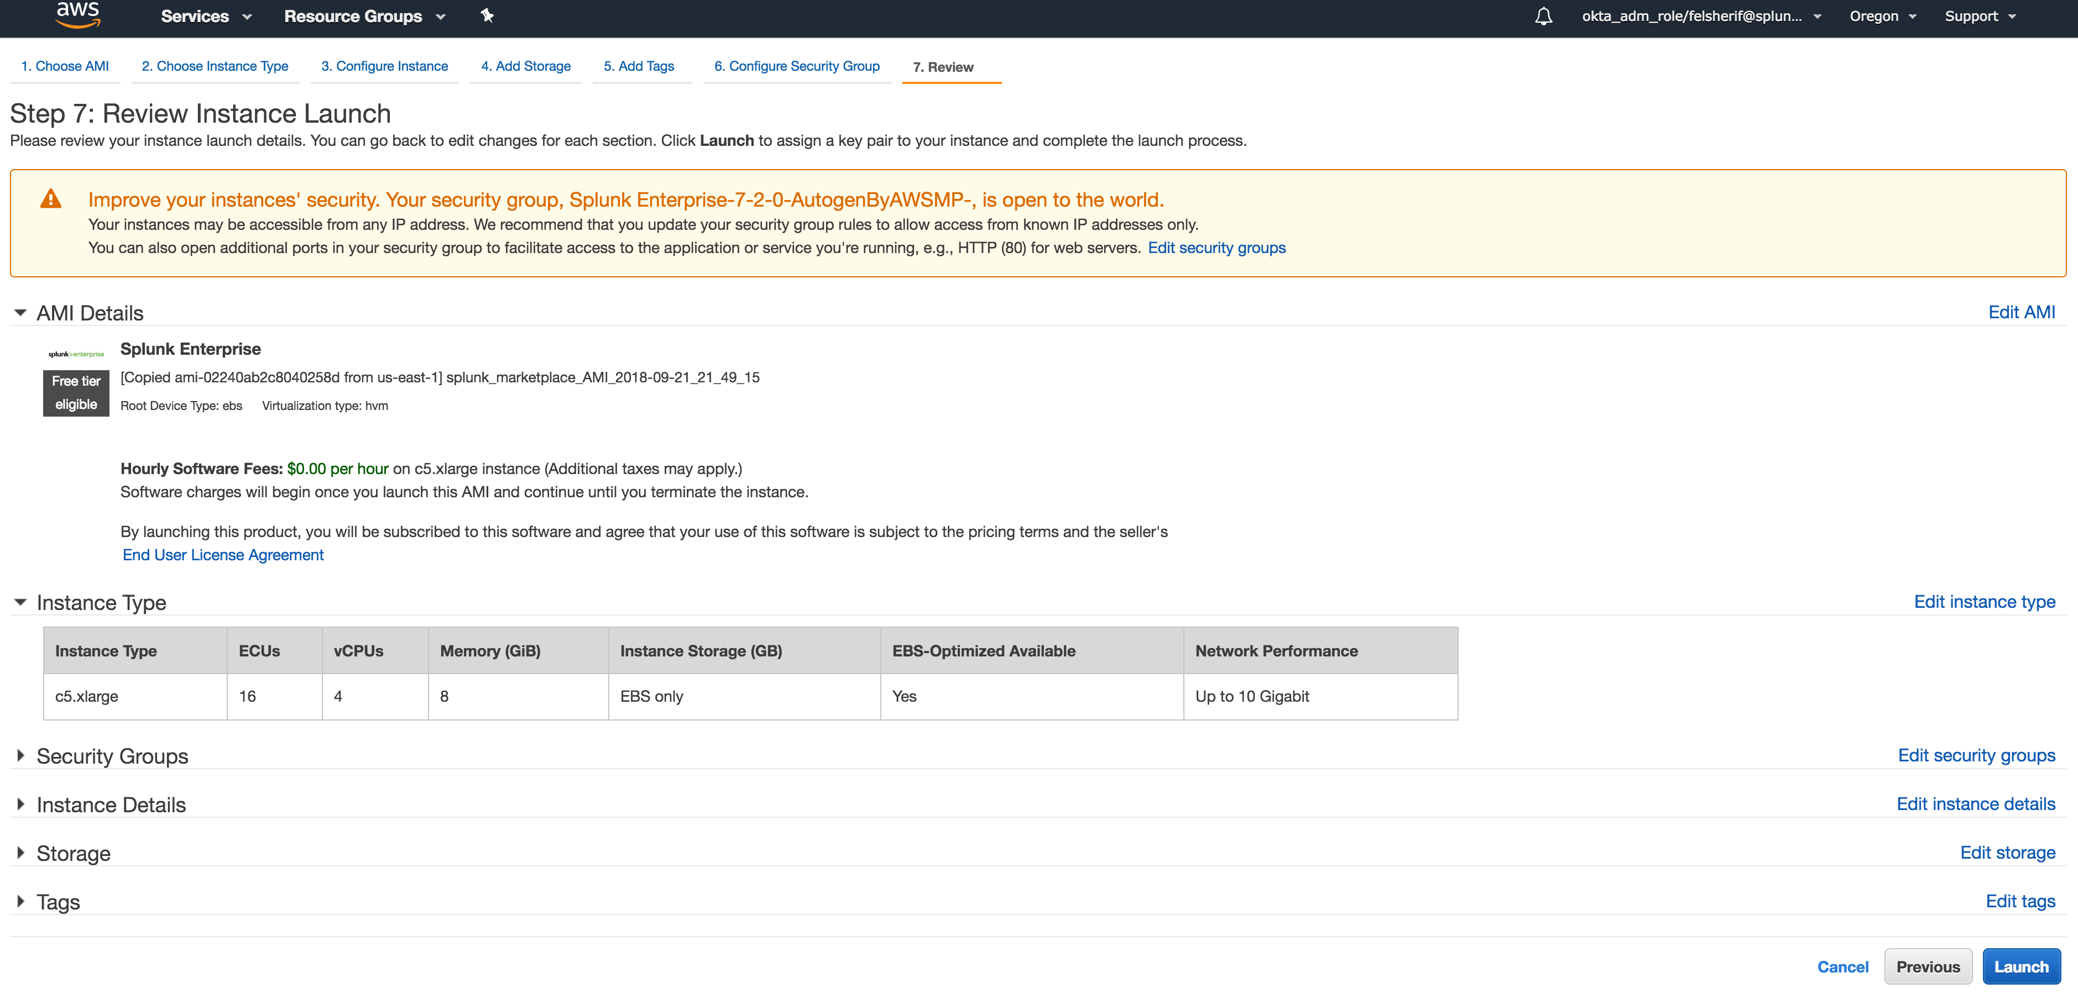
Launch and Download Keys
Click Here

Slide 15
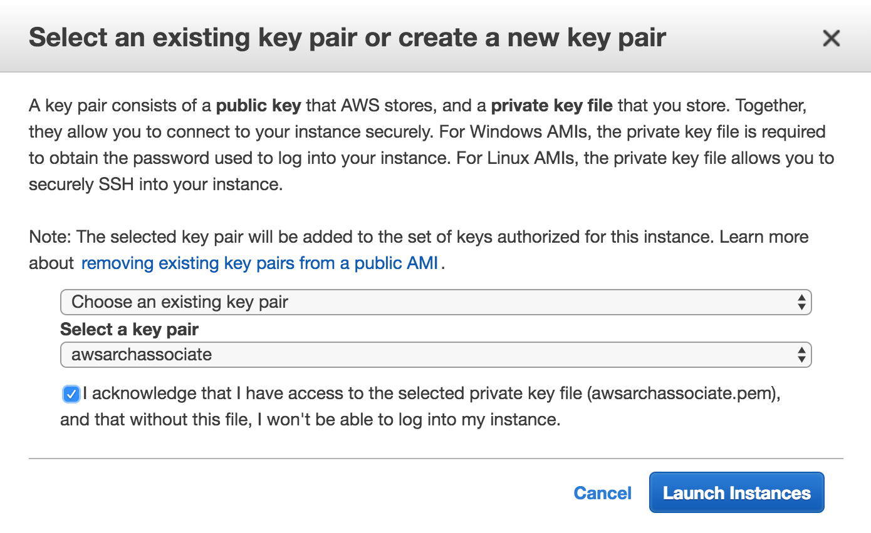
Launch and Download Keys
Click Here

Slide 16
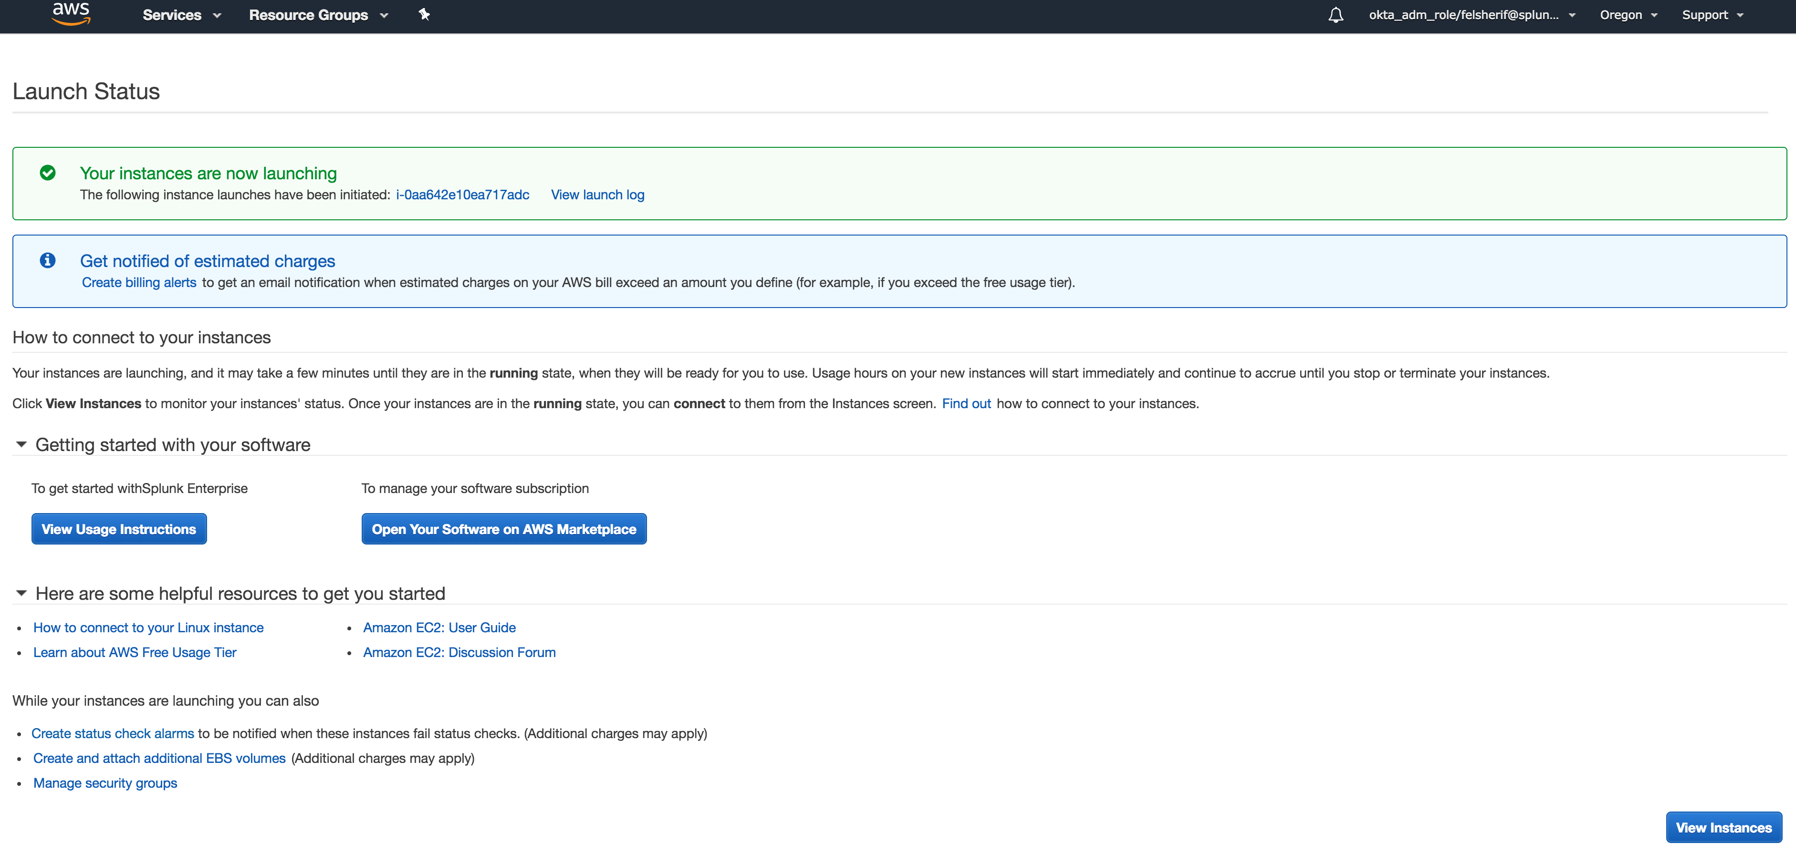
Successful Launch

Slide 17
Splunk Setup, now install App / Add-on
Install the Splunk App for AWS on the Search Head
The Splunk Add-on for AWS can be installed on the Search Head for testing NOT production
Install the Splunk Add-on for AWS on the HWF
Enable the HEC under Settings -> Data Inputs -> HEC -> Global Settings
Notes:
Make sure to install the Splunk App for AWS on your search head; if you are using a single instance then you can also install the Add-on in that instance. It is NOT recommended that you put any inputs on your search head since this will have an impact on your search performance. If you are using this in a production environment, make sure to install the AWS Add-on on a Heavy Weight Forwarder (HWF). Finally, make sure to enable your HTTP Event Collector on your collection node. Follow the steps in the next slide on how to setup a new token and sourcetype.

Slide 18
Please refer to
Cloud Formation Template Build
See Module 6: CloudFormation Templates for advanced instructions on setting up the AWS AMI / Quick Start
Notes:
For a more in-depth explanation on how to use CloudFormation templates, please look at module 6.

Slide 19
Install AWS App on Instance

Slide 20
Install AWS App and Dependencies
Manual Build
Install AWS App and dependencies
Splunk Add-on for AWS : https://splunkbase.splunk.com/app/1876/#/overview
Splunk App for AWS : https://splunkbase.splunk.com/app/1274/
Splunk ML Toolkit : https://splunkbase.splunk.com/app/2890/
Python for Scientific Computing (for Linux 64 bit) : https://splunkbase.splunk.com/app/2882/
Python for Scientific Computing (for Mac 64 bit) : https://splunkbase.splunk.com/app/2881/
Python for Scientific Computing (for Windows 64 bit) : https://splunkbase.splunk.com/app/2883/

Slide 21
Setup Splunk HEC
Once you’ve deployed your Splunk instance, and installed the AWS Add-on, setup the HEC to collect data from AWS

Slide 22
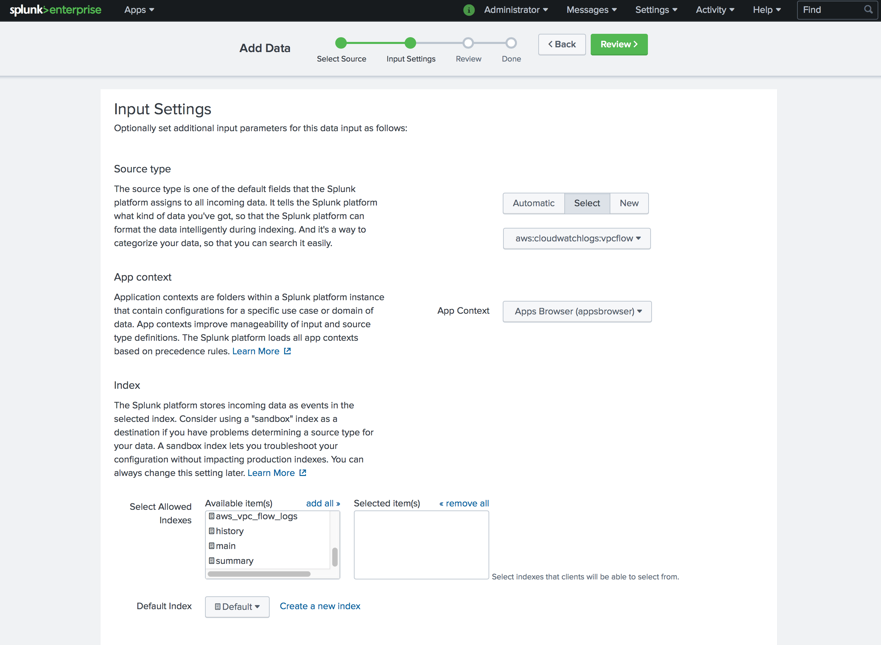
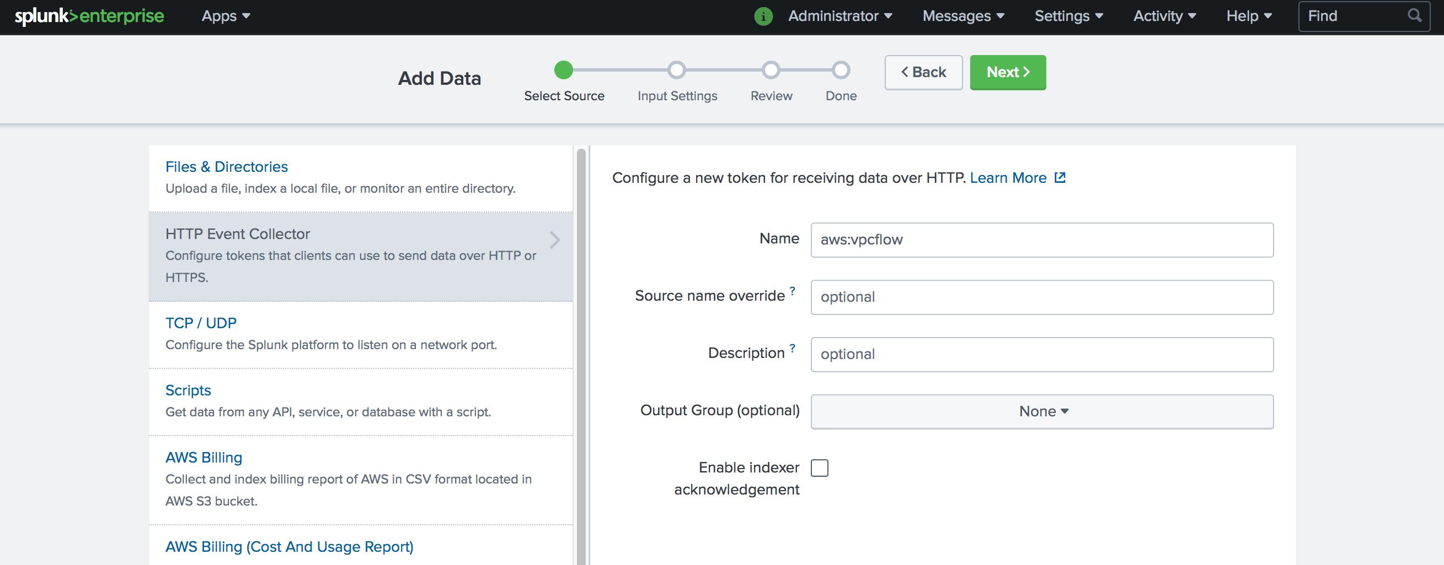
Setup HTTP Event Collector (HEC)
Enable HEC for VPCFlow and Lambda Function
Settings
Data Inputs
HTTP Event Collector
Add New Token
Sourcetype aws:cloudwatchlogs:vpcflow
Name HEC Endpoint (aws:vpcflow)
Index:
default
Notes:
Create a new HEC input, go to Settings -> Data Inputs -> HTTP Event Collector -> Add New token. Give the input a name, aws:vpcflow, and then make sure to select the sourcetype “aws:cloudwatchlogs:vpcflow.” If you do not have this sourcetype, make sure that the app / add-on were installed on your instance. Finally, keep the default index selected, unless you have changed the default index you are sending your AWS data. By default the app looks to the main index to find AWS data which it will use to populate the Summary Indexes.

Slide 23
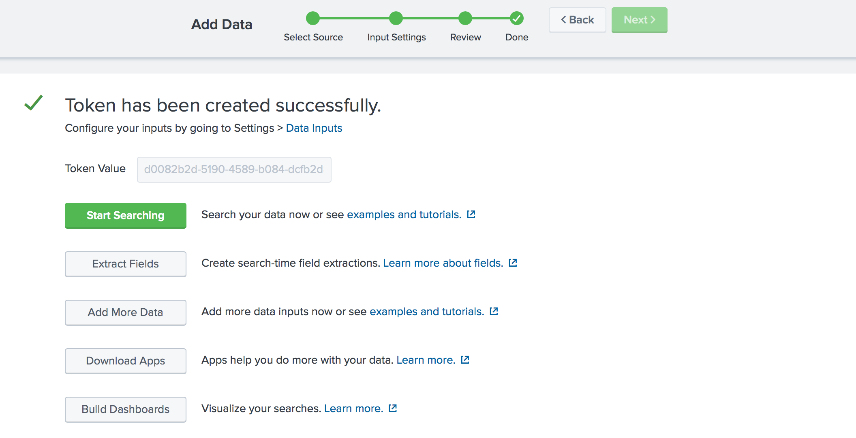
Setup HTTP Event Collector (HEC)
Start Searching the new token

Slide 24
Setup Lambda Function

Slide 25
Setup AWS Lambda
Enable AWS Lambda Functions
Select Splunk Lambda Function blue print
Splunk-CloudWatch-logs-processing
Configure Blue Print
Select CloudWatch Log Group (VPCFlowLogs)
Enable Trigger
Name Lambda Function (SplunkVPCFlowLogs)
Set Splunk Variables
Set SPLUNK_HEC_URL – https://<ip>/services/collector
Set SPLUNK_HEC_TOKEN
Create IAM Role with Lambda Execution enabled
Create Function

Slide 26
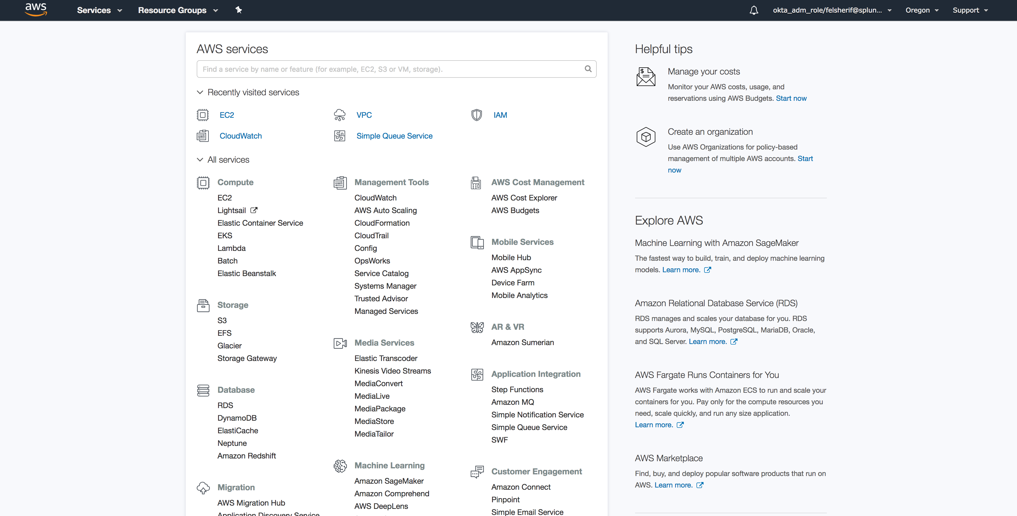
Setup AWS Lambda
Compute -> Lambda
Click Here
Notes:
Click on Lambda under Compute.

Slide 27
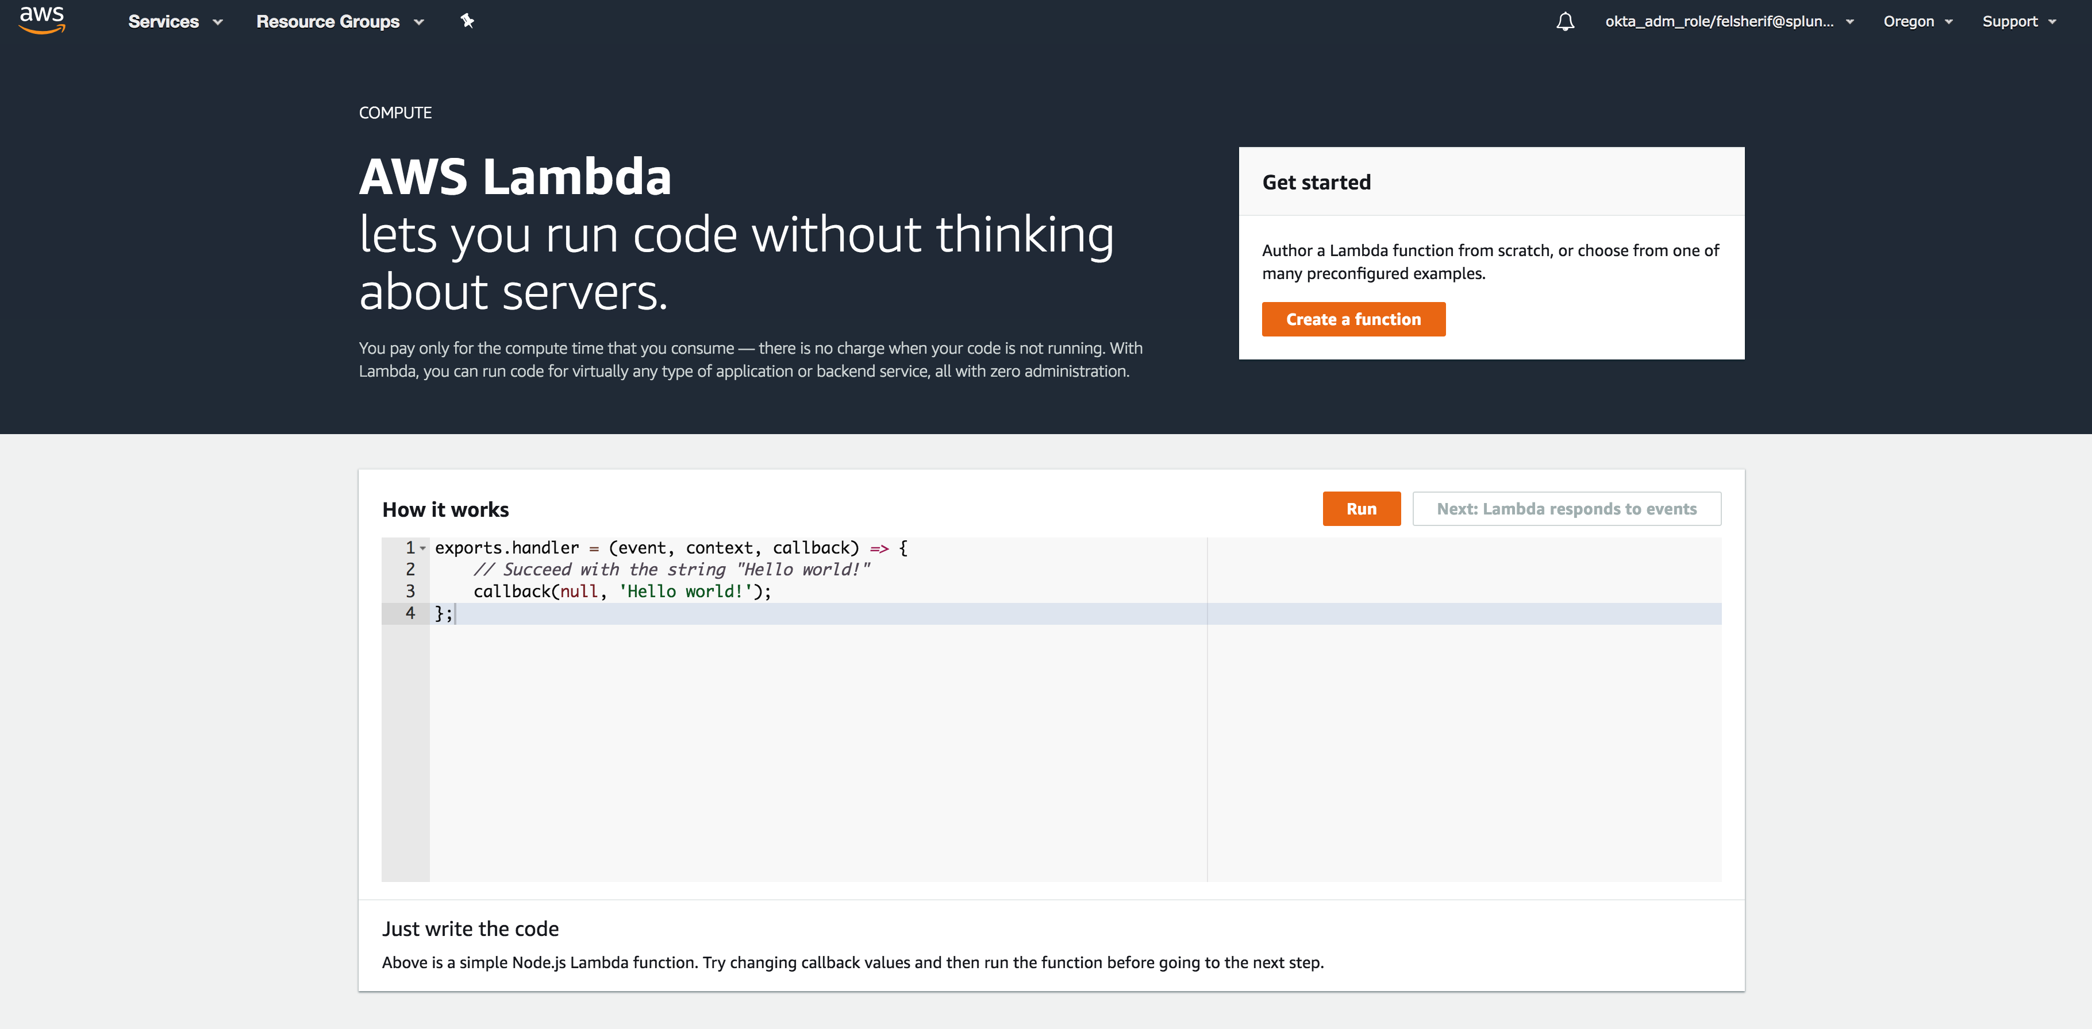
Setup AWS Lambda
Enable AWS Lambda Functions
Click Here
Notes:
Click on Get started now.

Slide 28
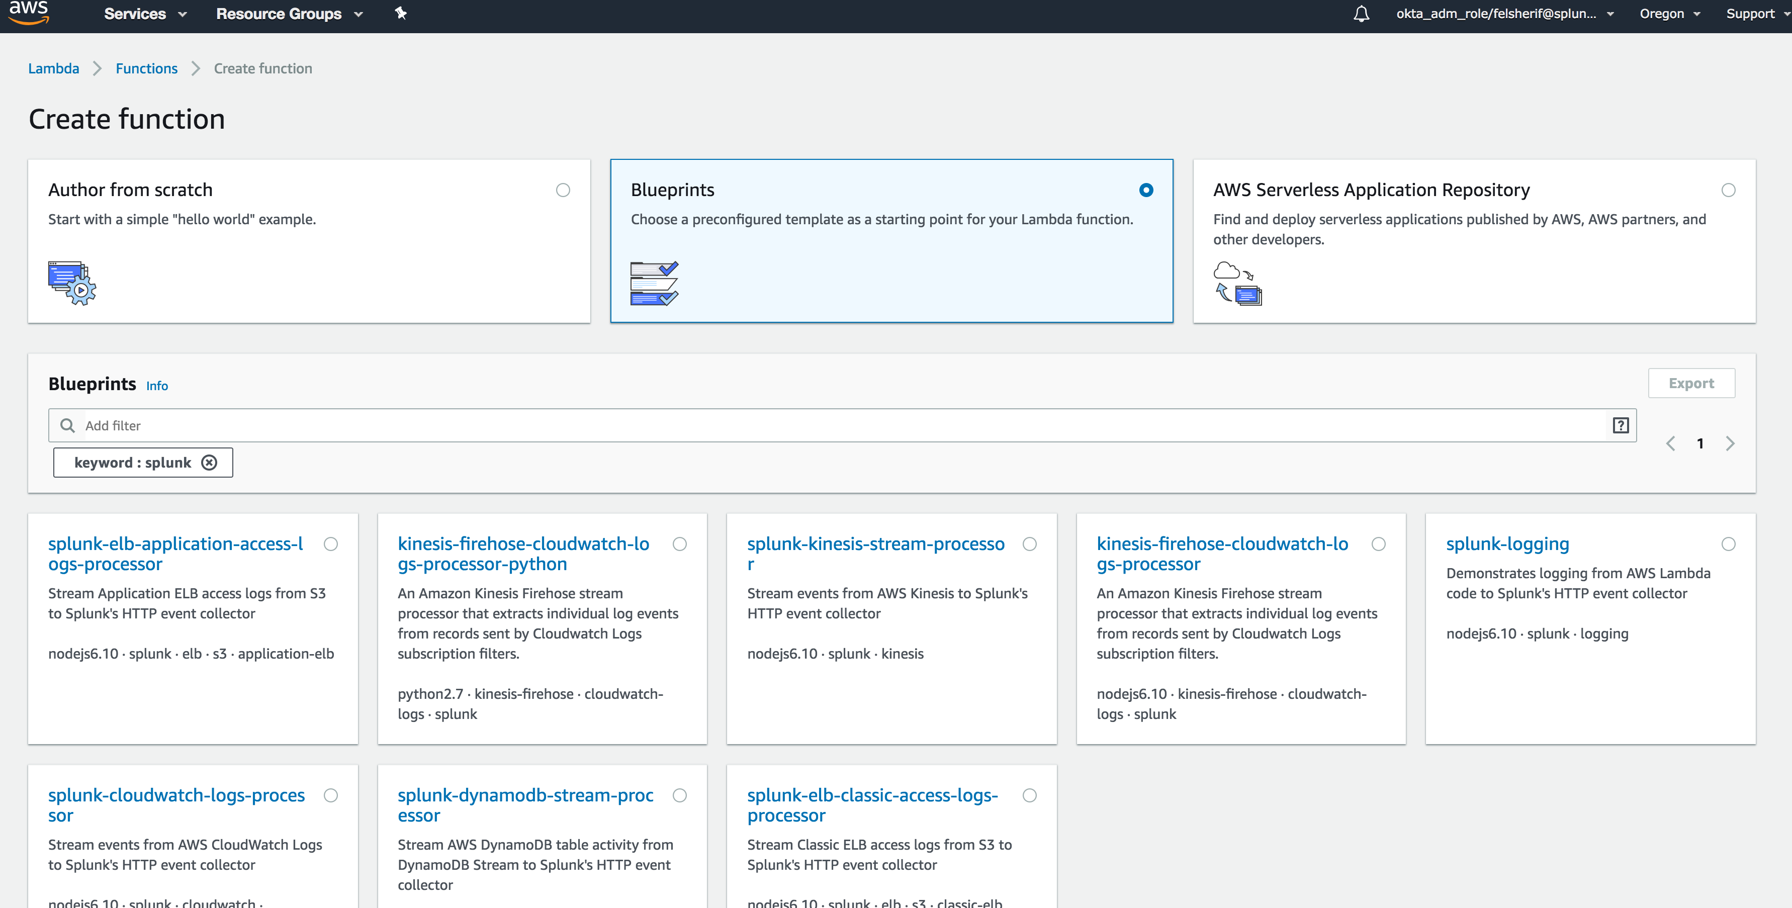
Setup AWS Lambda
Select ‘splunk-cloudwatch-logs-processing’ blue print
Select
Notes:
Click on Create Function, then search for the Splunk blue prints. Select the ‘splunk-cloudwatch-logs-processing’ blue print.

Slide 29
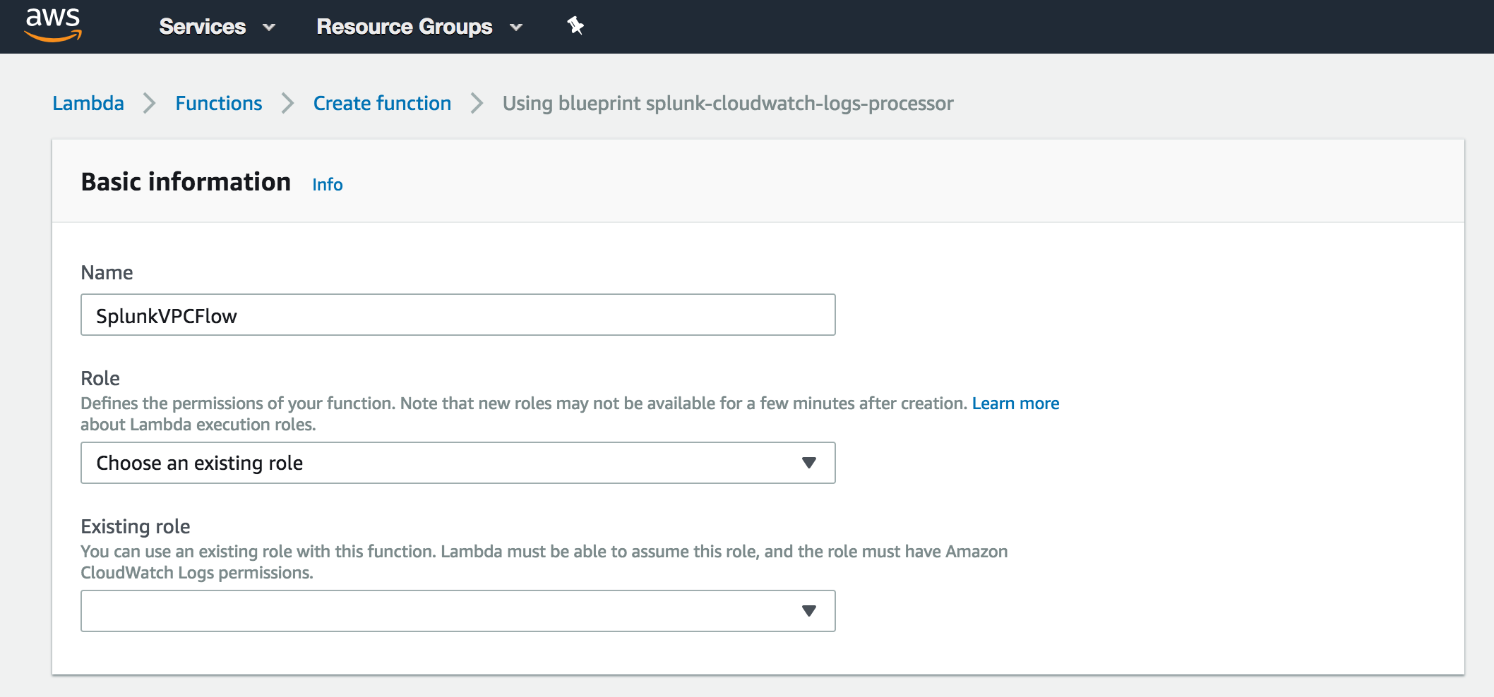
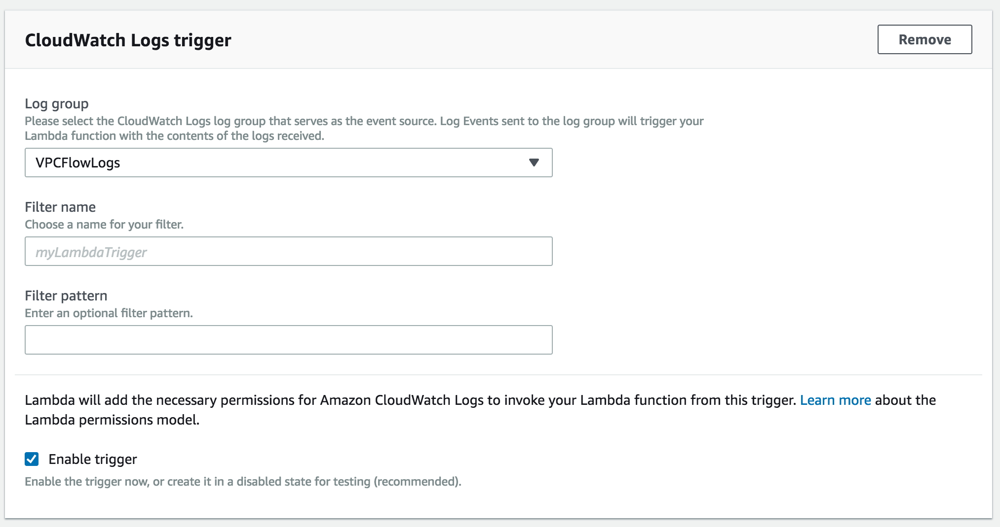
Setup AWS Lambda
Configure Function
Give your function a name and select the execution role, if it does not exist use the “Create a new role” [Next Slide]
Notes:
Give the function a name, like “vpcFlowLogsFunction.” If this is the first time you’re setting up Lambda Function you will need to create a new role. That is detailed in the next slide.

Slide 30
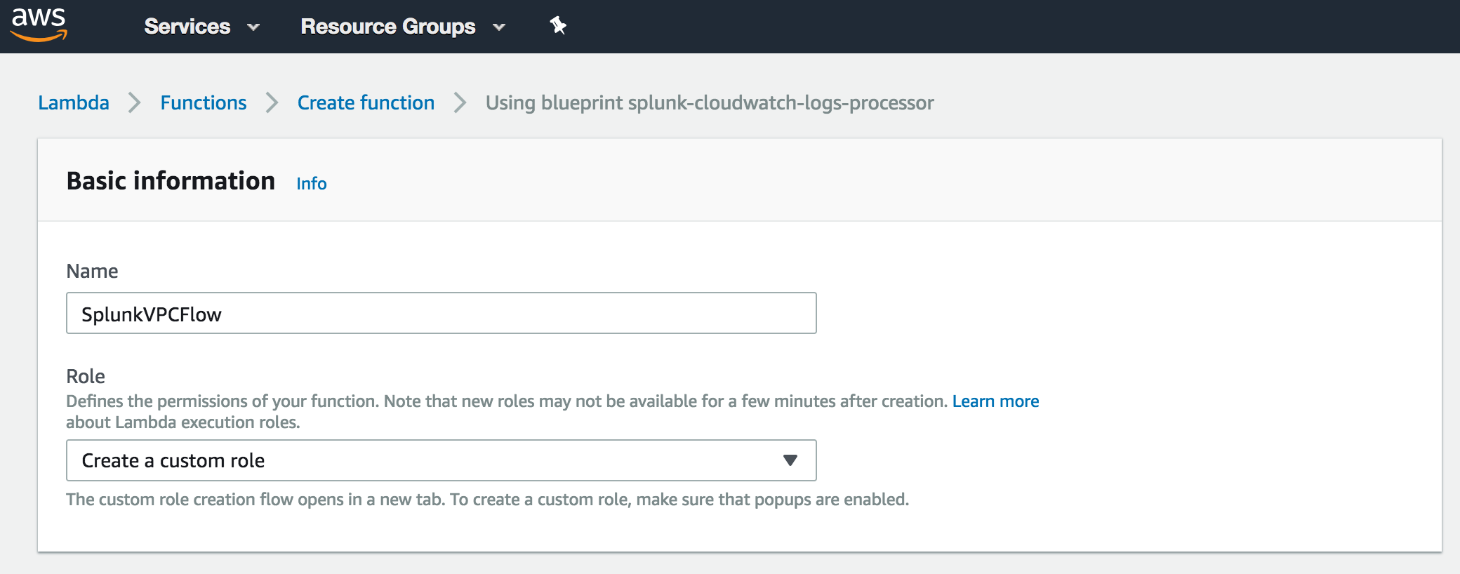
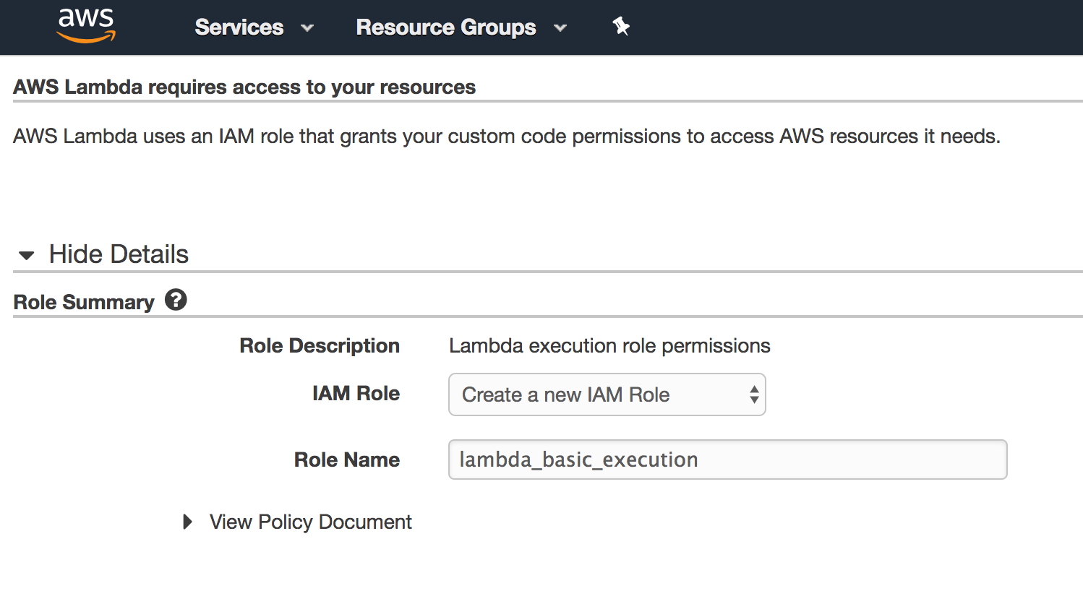
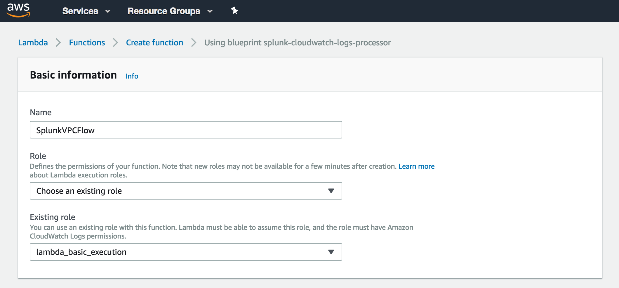
Lambda – How to create custom role
Create IAM Role with Lambda Execution enabled
New Custom
IAM Role
Create Role
Enable Lambda Function
1) Select “Create a new role”
2) Create lambda_basic_execution
Click Allow
3) Validate that the new role ‘lambda_basic_execution’ is selected and select your CloudWatch Log group that will trigger this Lambda Function.
Notes:
1) Once you’ve selected “Create new role,” you will be taken to a new tab where the ‘lambda_basic_execution’ role has been created for you. 2) Click on allow and then go back to your screen for creating the Lambda function, select the newly created role ‘lambda_basic_execution.’ 3) Select the CloudWatch Log group you created earlier, VPCFlowLogsGroup, that will trigger this Lambda function.

Slide 31
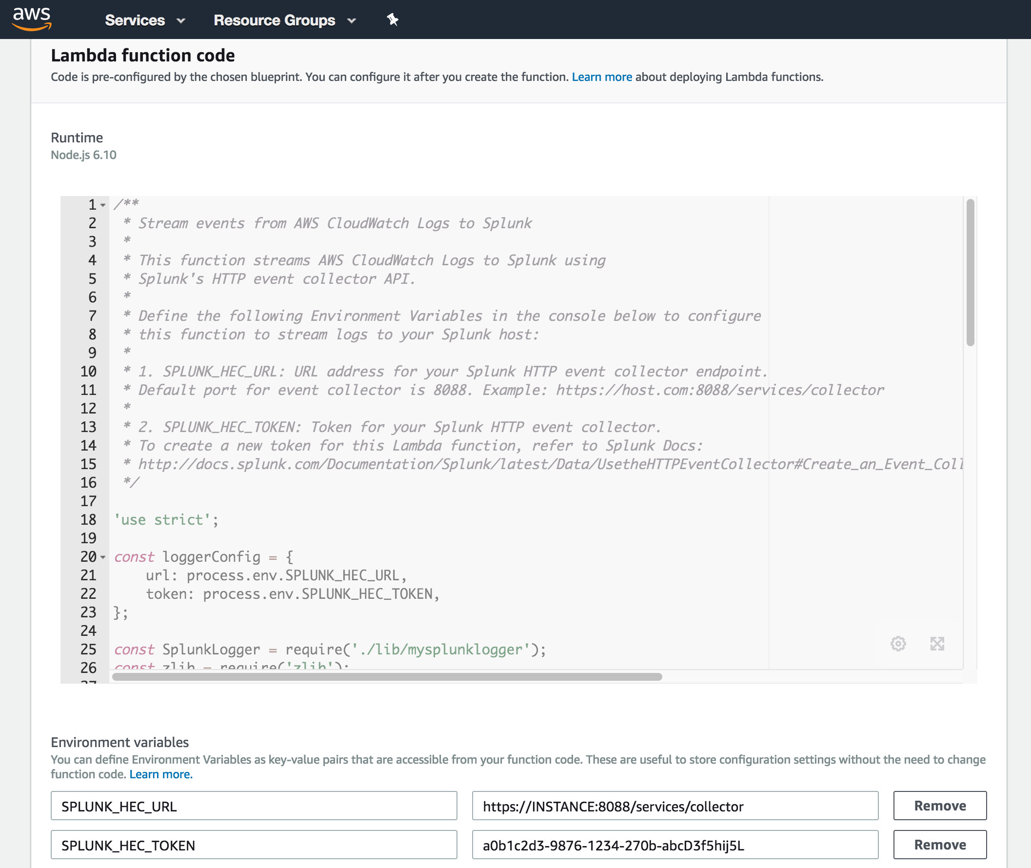
Setup AWS Lambda
Fill in variables HEC_URL, HEC_TOKEN
SPLUNK_HEC_URL = https://<host>:8088/services/collector
Splunk Cloud URL :
https://http-inputs-<customer>.splunkcloud.com/services/collector
Splunk Cloud Trial URL :
https://input-<trial>.cloud.splunk.com:8088/services/collector
Splunk AMI:
https://<ip_add>:8088/services/collector
Notes:
Once you’ve named your function, given it permission to execute and selected the CloudWatch Log group to trigger the function you will now just need to fill out two variables for the script. The first he the HEC_URL which is the endpoint where the data will be sent. If you have :
- a Splunk Cloud instance, the URL will be https://http-input-<customer>.splunkcloud.com/services/collector
- a Splunk Cloud Sales Trial, the URL will be https://input-<trial>.cloud.splunk.com:8088/services/collector
- a Splunk AMI from marketplace, the URL should be https://<ip_address>:8088/services/collector
Finally, put in your HEC Token from when you created the HEC input and click ”Create Function.”

Slide 32
Continue to Module 4: Setting Up Splunk App for AWS

